Slide 1
Consider the following example of a wellbore that contains an electric submersible pump (ESP) as shown in the following diagram
wellhead
wellbore
motor current
motor temp
motor pressure
electric submersible pump
(ESP01)
bottomhole pressure
Let’s also assume that we want to measure the ESP motor current, motor temperature, and motor pressure as well as the bottomhole pressure for the wellbore. One could construct an product flow model identifying each entity (wellbore, ESP, wellhead, etc.) at a very granular level. However, this approach can quickly lead to a complex flow model with many levels of embedded models.
Alternatively, we can include the internal facility information as part of the wellbore to simplify our model, as shown in the following illustration

Slide 2
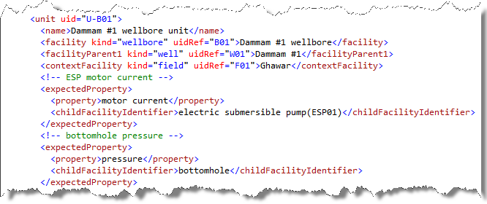
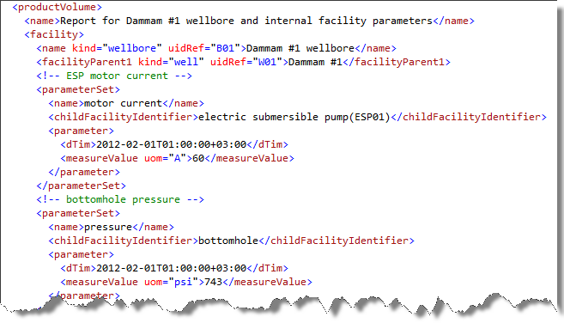
Product Flow Model
Product Volume Report for Wellbore

